Slide 1
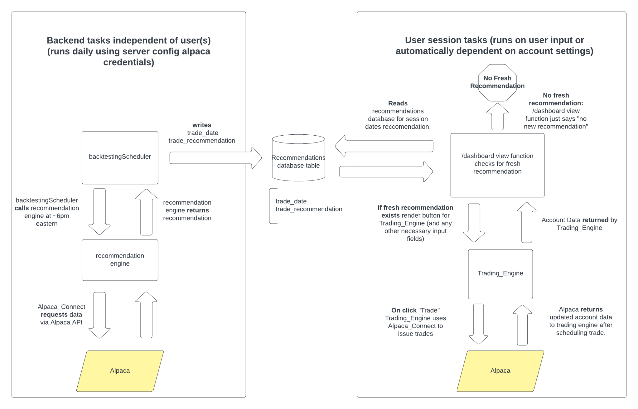
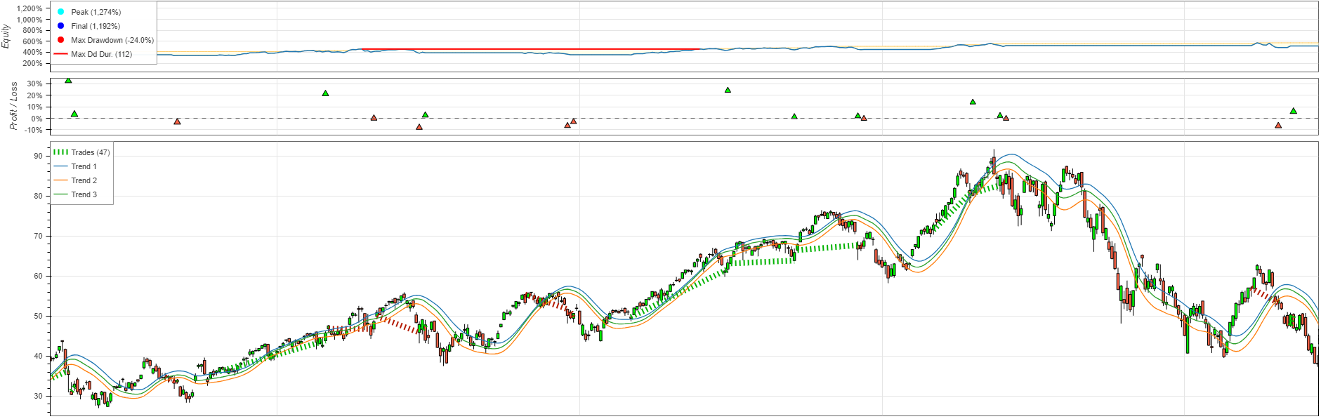
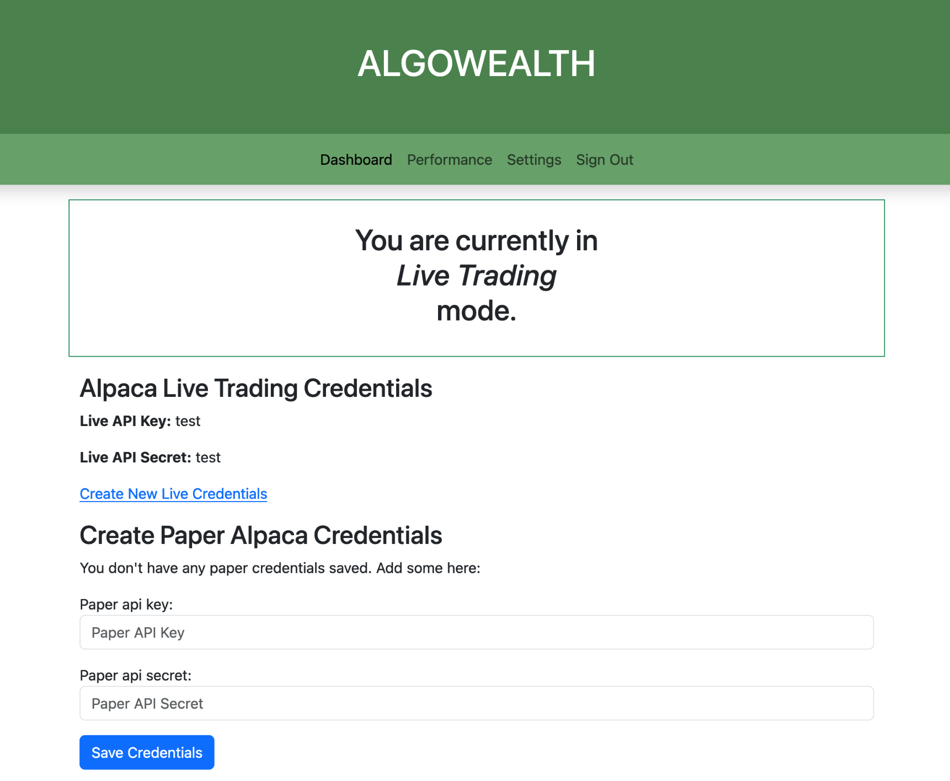
Investment Recommendations using Algorithmic Stock Market Trading Strategies
This project created an automated trading algorithm that analyzes daily stock market performance using a proprietary algorithm, and automatically sends orders to our broker using an API.
Example graph of backtesting the algorithm
Basic application architecture
Description and Features
This project started with a proprietary algorithm provided by our sponsor to analyze past stock market data to verify its performance.
We chose Alpaca which provides an API to send and receive market data and orders. Users can utilize both paper and live trading.
This project is split into both a backend and a frontend portion, both contained within a single Django application. The application runs daily and works by getting live stock data through Alpaca’s API and using that data to run the recommendation engine. The resulting recommendation for the current day is passed into a SQLite database.
The user receives the recommendation via the frontend web application, which also allows for them to place orders, view their order history and account performance.
The backend utilizes APScheduler, a task scheduling library, to generate the latest recommendation shortly after market close.
Team Members
Logan Jensen (jensenlo@oregonstate.edu)
Amar Jilani (jilania@oregonstate.edu)
Noah Lawler (lawlern@oregonstate.edu)
David Mingeaud (mingeaud@oregonstate.edu)
Webapp user interface

